Slide 1
Posters in PowerPoint

Slide 2
What should you include?
Typically 4-8 sections
Please check with you instructor on what all they would like you to include
Columns are read from left to right down each column

Slide 3
Poster Sizing
Standard poster size is 48”x 36” in landscape orientation
Others can be used, but please check if there is a minimum or maximum size for the poster
To check or change the sizing of the poster for printing:
For Google Slides
Click on File
Click on Page Setup
Click on Custom
Set the height and width of the poster
Click on Apply
For Microsoft PowerPoint
Click on Design
Click on Slide Size
Click on Custom
Set the height and width of the poster
Click on OK
Click on Ensure Fit

Slide 4
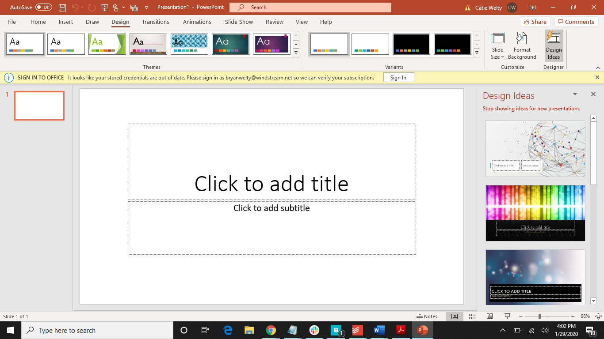
1.
2.

Slide 5
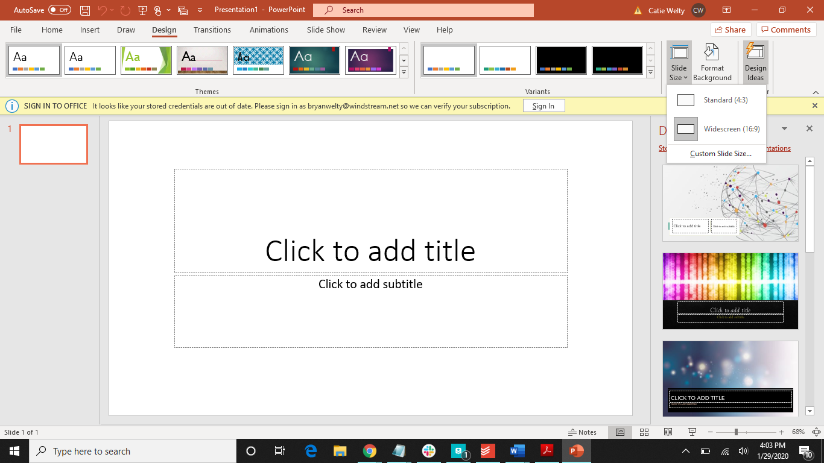
3.

Slide 6

4.
5.

Slide 7
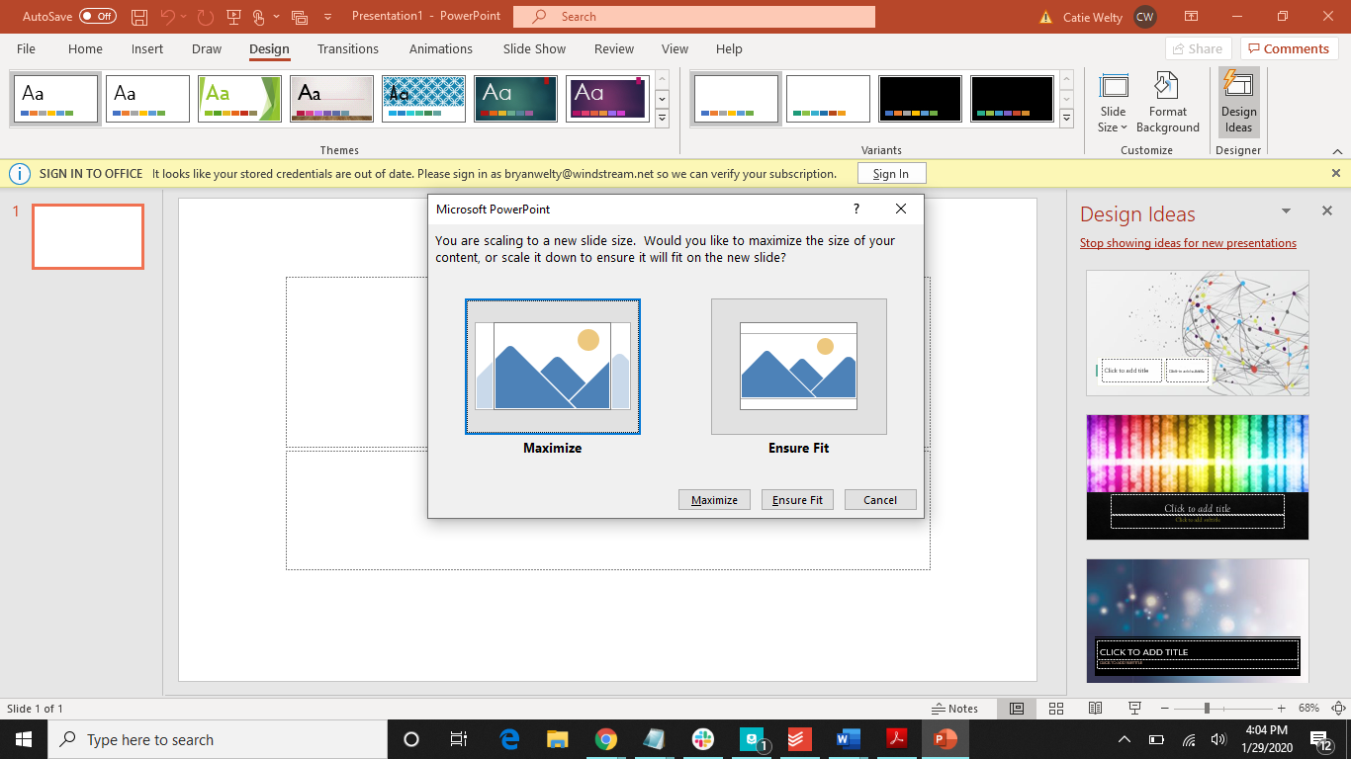
6.

Slide 8
Poster Design Tips
When designing your poster, remember simple is better
Keep the background non-distracting
White or light colors is recommended
Important information should stand out more through the use of different font sizes and/or bolding
Line up things so it is clear how the poster is to be read
Don’t crowd images and the text if possible
Make sure that the headings and the title are easily distinguished from the rest of the text

Slide 9
Fonts
Make sure to use a font that is easy to read
Use can use the same font for both the headings and the text or you can use two different fonts
On the next slide are some good fonts to use (you can use these pairs, or choose one to use)
Also make sure all text on the poster can be read from a standard of four feet away
To the left are some recommended font sizes
Line spacing is recommended to be between 1.25 and 1.5
Title 85 pt
Authors 56 pt
Headings 36 pt
Body Text 24 pt
Captions 18 pt

Slide 10
Good Font Options
Title | Heading
Bree Serif | Open Sans
Nunito | Open Sans
Montserrat | Courier New
Play Fair Display | Source Code Pro
Source Code Pro | Times New Roman

Slide 11
Poster Theme
Color should be used to capture the viewer’s attention
While color is recommended, be careful that the color is not distracting
Use color to make data points stand, the headings easier to see, and to highlight important information

Slide 12
Charts and Tables
Charts and tables are great ways to reduce the amount of text on your poster
Remove the following if they aren’t needed:
Borders
Lines
Labels
Markers
Backgrounds
Ensure the colors on the charts and tables make with the theme of the poster

Slide 13
Images
Images are another great way to reduce the text on your poster
Check image resolution before using
Low resolution may print out fuzzy and distorted

Slide 14
Tips for Creating Your Poster
Before adding information, plan out where the sections will be
In order to edit the text, especially the smaller text, zoom in
Click on the magnifying glass
Click on the poster once
Click on the magnifying glass again
Make sure to edit the poster dimensions before you start anything
For Microsoft PowerPoint, use the sliding magnifier at the bottom.

Slide 15
Assignment
Create a sample poster. It should be sized correctly and have the following:
Title
Five information boxes
You don’t need accurate information, just type a general description of what could be put in each box.
Use appropriate fonts and font sizes.

Slide 16

Have more questions?
Email us at ccla@doane.edu or come visit us in Communications 188D from 9am to 5pm.
You can also visit our website at https://www.doane.edu/ccla

Slide 17
References
MakeSigns. (n.d.). Scientific Poster Tutorials - How To Make a Research Poster. Retrieved from https://www.makesigns.com/tutorials/
Typography, Design Inspiration, Design Tutorials. (2019, August 26). 10 Beautiful Font Combinations For All Your Design Needs. Retrieved from https://inkbotdesign.com/font-combinations/

Slide 18
Please provide some feedback on the presentation by following the QR Code below.

